Slide 1
UNIT – II
Characteristics of Graphical
and Web User Interfaces

Slide 2
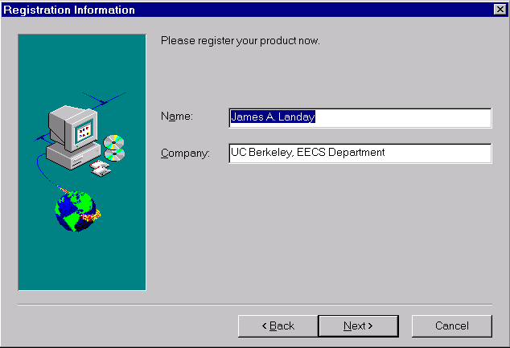
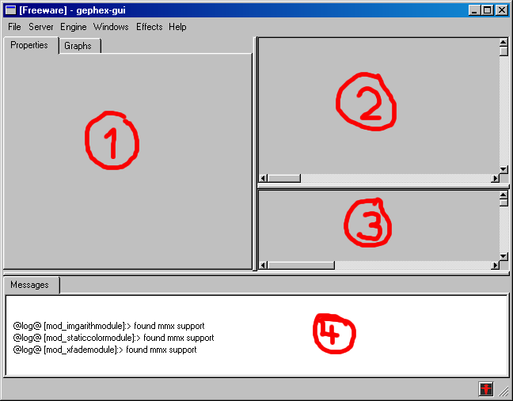
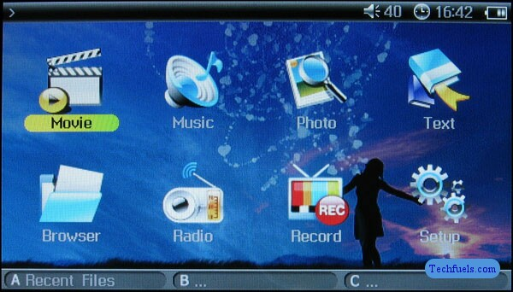
The Graphical User Interface

Slide 3
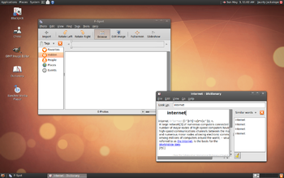
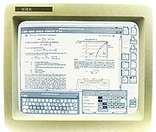
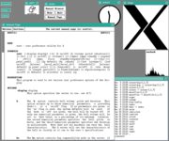
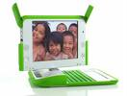
A graphical user interface (GUI) is a type of user interface item that allows people to interact with programs in more ways than typing
Examples:
computers
hand-held devices : MP3 Players, Portable Media Players or Gaming devices; household appliances and office equipment with images rather than text commands.
A GUI offers graphical icons, and visual indicators, as opposed to text-based interfaces, typed command labels or text navigation to fully represent the information and actions available to a user.

Slide 4

WEB USER INTERFACE
Accept input and provide output by generating web pages which are transmitted via the Internet and viewed by the user using a web browser program

Slide 5
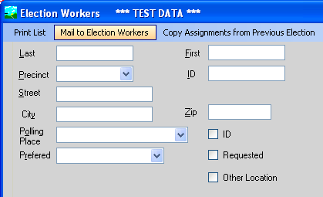
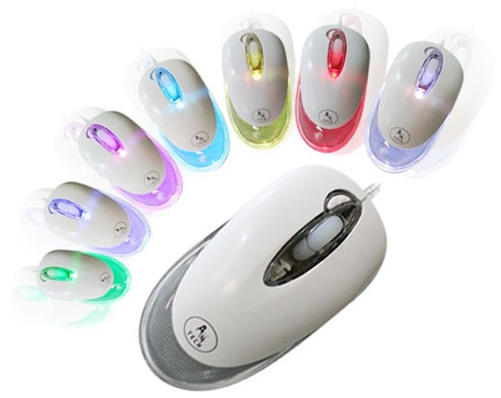
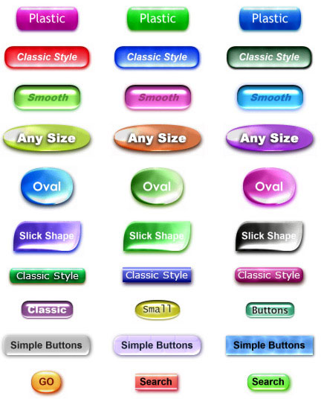
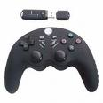
The Popularity of Graphics
Text-based screen
2D-based screen
3D-based screen
Text could be replaced by graphical images
Screen navigation and commands are executed through menu bars and pull-downs.
Menus “pop up” on the screen
Screen body, selection fields such as radio buttons, check boxes, list boxes, and palettes coexisted with the reliable old text entry field.
Text entry fields with attached or drop-down menus of alternatives also became available
Screen objects and actions were selected through use of pointing mechanisms, such as the mouse or joystick, instead of the traditional keyboard.

Slide 6
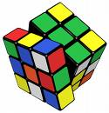
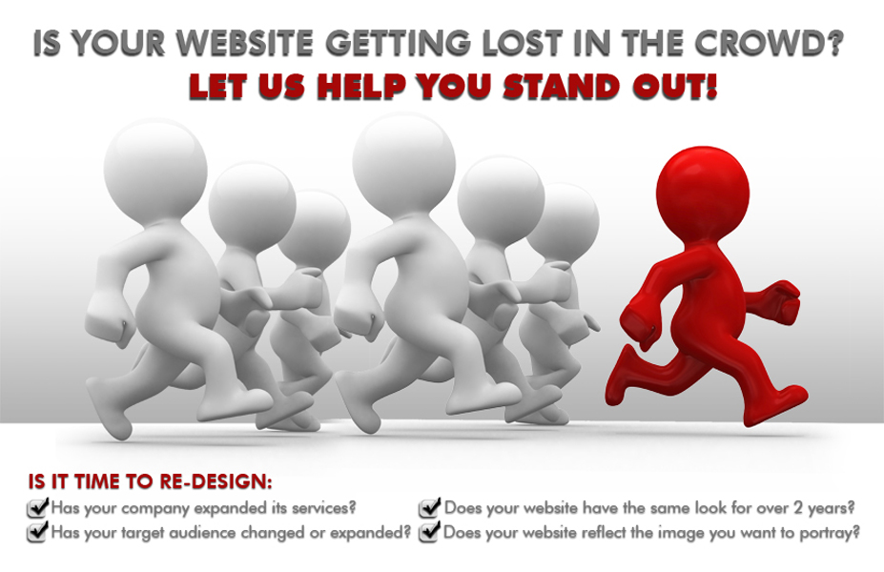
Desktop reffered as WIMP interface: windows, icons, menus, and pointers.
Graphic Presentation:- person’s information-processing capabilities much more effective than other presentation methods
Properly used, it reduces the requirement for perceptual and mental information recoding and reorganization, and also reduces the memory loads.
Graphics also can add appeal or charm to the interface and permit greater customization to create a unique corporate or organization style
Faster information transfer between computers and people by permitting more visual comparisons of amounts, trends, or relationships.
More compact representation of information; and simplification of the perception of structure.

Slide 7
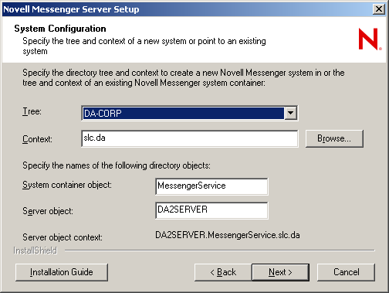
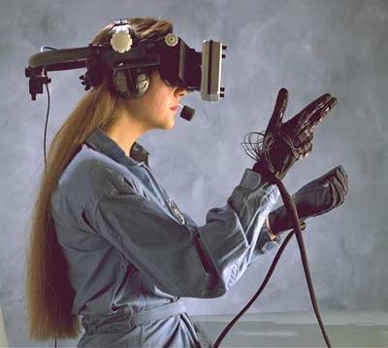
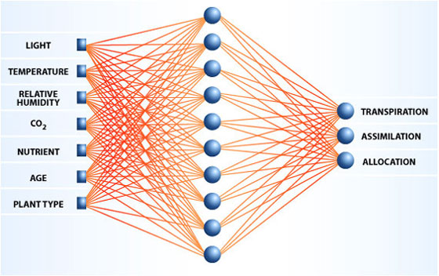
The Concept of Direct Manipulation by Shneiderman (1982)
style of interaction for graphical systems
The system is portrayed as an extension of the real world
A person has the power to access and modify these objects
focus on the data, not the application and tools.
Continuous visibility of objects and actions
“virtual reality” by Nelson
“WYSIWYG” (what you see is what you get). By Hatfield
Rutkowski (1982) described it as “transparency,”
Actions are rapid and incremental with visible display of results
The results of actions are immediately displayed visually on the
screen in their new and current form.
Incremental actions are easily reversible
Finally, actions, if discovered to be incorrect or not desired, can be easily undone.

Slide 8
Direct manipulation may not be feasible
The operation may be difficult to conceptualize in the graphical system.
The graphics capability of the system may be limited.
The amount of space available for placing manipulation controls in the window border may be limited.
It may be difficult for people to learn and remember all the necessary operations and actions.

Slide 9
Indirect Manipulation
Indirect manipulation substitutes words and text, such as pull-down or pop-up menus, for symbols, and substitutes typing for pointing.
When an operation is selected from the list, by pointing or typing, the system executes it as a command.
Which style of interaction—direct manipulation, indirect manipulation, or a combi-
nation of both—is best ???????

Slide 10
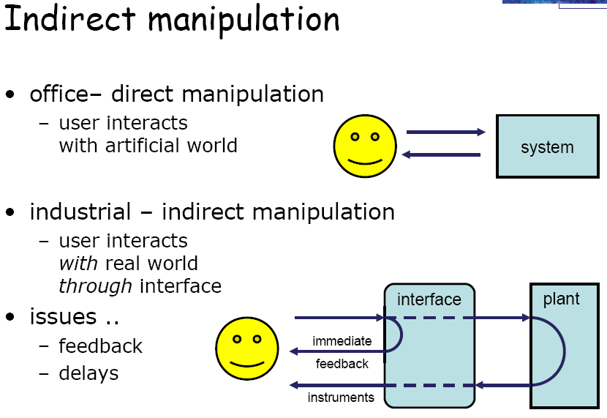

Slide 11
Advantages | Disadvantages
Symbols recognized faster than text | Hardware limitations.
Faster learning | Inefficient for expert users.
Faster use and problem solving. | Inefficient for touch typists
Easier remembering | Few tested icons exist.
More natural. | Learning still necessary.
Exploits visual/spatial cues | Greater design complexity.
Provides context. | Lack of experimentally-derived design guidelines.
Fewer errors. | Inconsistencies in technique and terminology.
Increased feeling of control. | Not always familiar.
Immediate feedback. | The futz and fiddle factor(Games,mouse)
Predictable system responses | Human comprehension limitations.
Easily reversible actions | Production limitations (symbols)
Less anxiety concerning use | Not always fastest style of interaction.(ATM)
More attractive | Increased chances of clutter and confusion.
May consume less space. | May consume more screen space.
Replaces national languages | Not always fastest style of interaction
Low typing requirements | Not always the preferred style of interaction.
Smooth transition from command language system.

Slide 12
Characteristics of the Graphical User Interface
Sophisticated Visual Presentation.
Pick-and-Click Interaction
Restricted Set of Interface Options
Visualization
Object Orientation
Properties or Attributes of Objects
Actions
Application versus Object or Data Orientation
Views
Use of Recognition Memory
Concurrent Performance of Functions

Slide 13

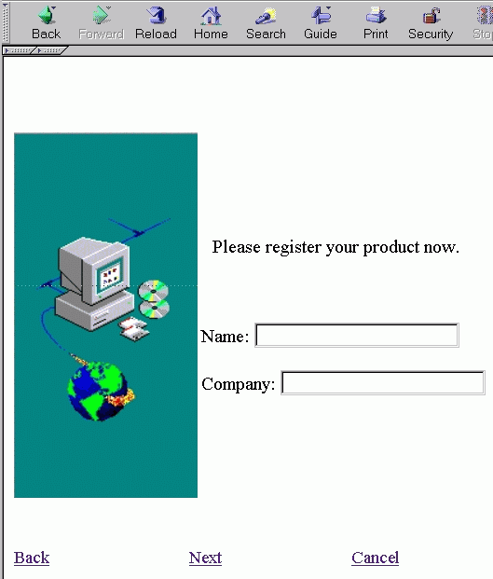
The Web User Interface

Slide 14
Web interface design is essentially the design of navigation and the presentation of information. It is about content, not data.
The design goal is to build a hierarchy of menus and pages that feels natural, is well structured, is easy to use, and is truthful.
The Web is a navigation environment where people move between pages of information, not an application environment. It is also a graphically rich environment.
Web interface is a victim of its poor foundation.
Victim of its explosive and haphazard growth.
Web interface design is also more difficult because the main issues concern information architecture and task flow, neither of which is easy to standardize.
It is more difficult because of the availability of the various types of multimedia, and the desire of many designers to use something simply because it is available.
It is more difficult because users are ill defined, and the user’s tools so variable in nature.

Slide 15
Popularity / History of web
It allows millions of people scattered across the globe to communicate, access information, publish, and be heard.
It allows people to control much of the display and the rendering of Web pages
1984, hosts online exceeded 1,000;
1987, 10,000;
1989, 100,000,
1990,300,000;
1992 hosts exceeded one million
In 1993, Internet traffic was expanding at a 341,634 percent annual growth rate.
In 1996, there were nearly 10 million hosts online and 40 million connected people
Slow download times, confusing navigation, confusing page organization, disturbing animation, or other undesirable site features often results in user abandonment of the site

Slide 16
Printed Pages versus Web Pages
Page size.
Page rendering.
Page layout.
Page resolution.
User focus
Page navigation
Page independence
Interactivity.
Sense of place.

Slide 17
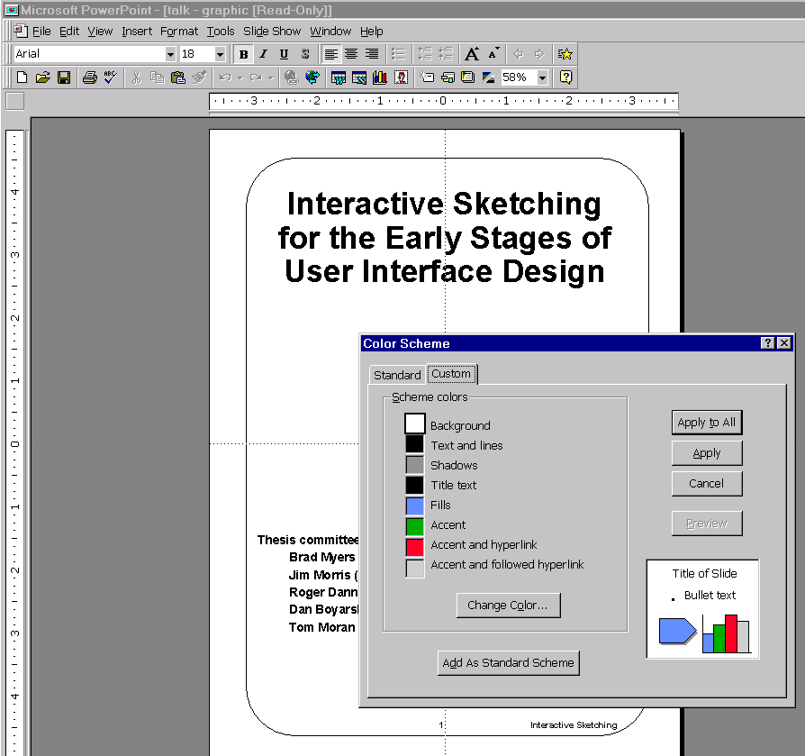
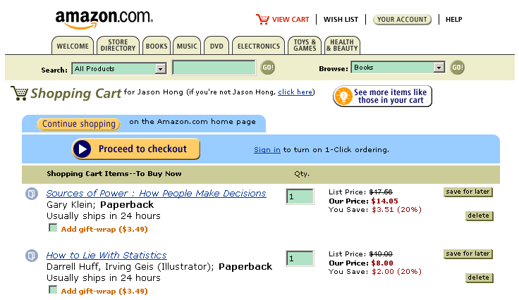
Differences between Graphical and Web User Interfaces

Slide 18
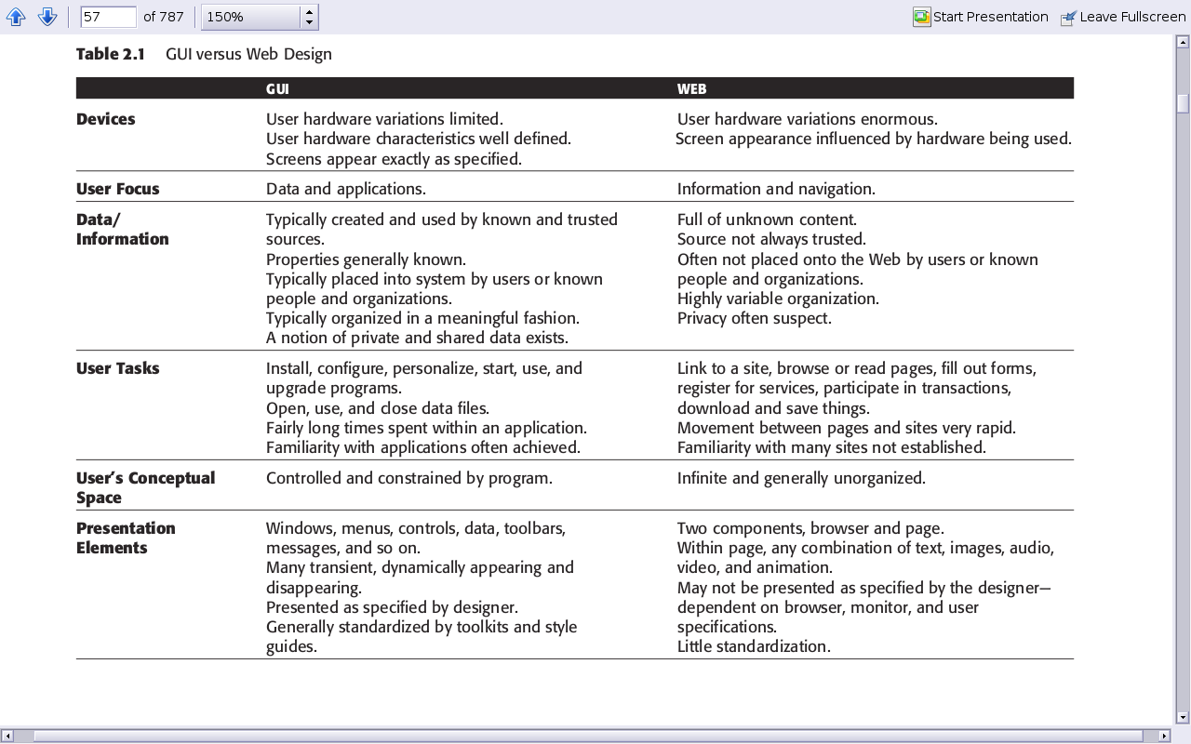

Slide 19
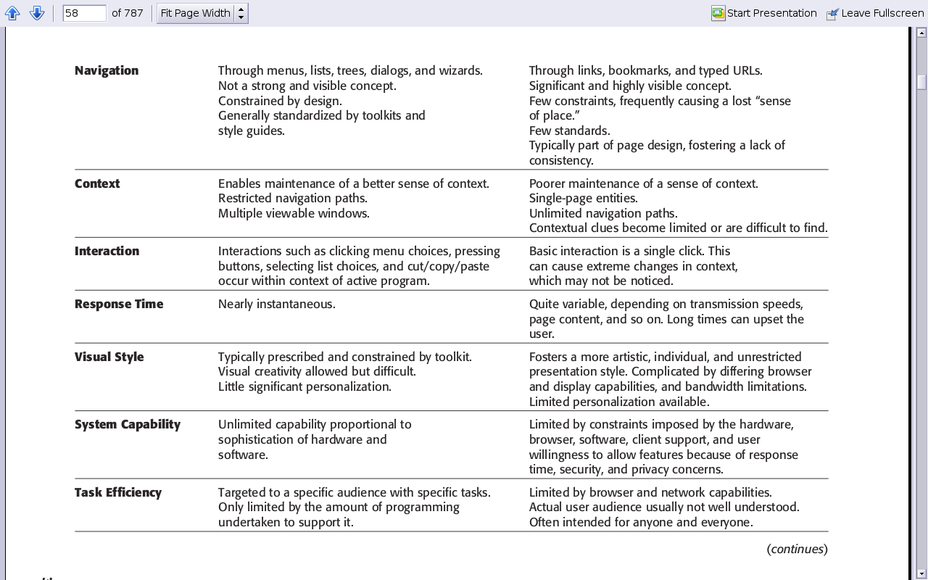

Slide 20
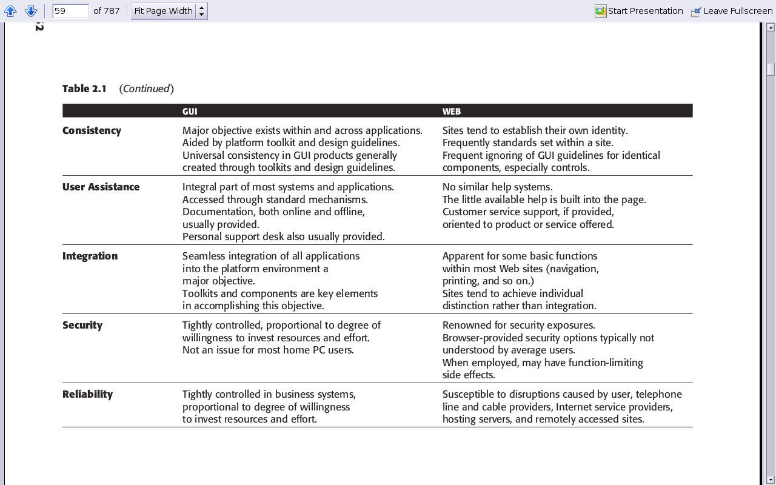

Slide 21
Principles of User Interface Design
Aesthetically Pleasing
Clarity
Compatibility
User compatibility
Task and job compatibility.
Product compatibility.
Comprehensibility
Configurability
Consistency
Control
Directness
Efficiency
Familiarity
Flexibility
Forgiveness
Predictability
Recovery
Responsiveness
Simplicity
Transparency
Trade-Offs

Slide 22
Aesthetically Pleasing:
Provide visual appeal by following these presentation and graphic design principles:
— Provide meaningful contrast between screen elements.
— Create groupings.
— Align screen elements and groups.
— Provide three-dimensional representation.
— Use color and graphics effectively and simply.

Slide 23
Clarity:
■ The interface should be visually, conceptually, and linguistically clear, including:
— Visual elements
— Functions
— Metaphors
— Words and text
Compatibility:
■ Provide compatibility with the following:
— The user
— The task and job
— The product
■ Adopt the user’s perspective.

Slide 24
Comprehensibility:
■ A system should be easily learned and understood. A user should know the following:
— What to look at
— What to do
— When to do it
— Where to do it
— Why to do it
— How to do it
■ The flow of actions, responses, visual presentations, and information should be in a
sensible order that is easy to recollect and place in context.
Configurability:
■ Permit easy personalization, configuration, and reconfiguration of settings.
— Enhances a sense of control.
— Encourages an active role in understanding.

Slide 25
Consistency:
■ A system should look, act, and operate the same throughout. Similar components
should:
— Have a similar look.
— Have similar uses.
— Operate similarly.
■ The same action should always yield the same result.
■ The function of elements should not change.
■ The position of standard elements should not change.

Slide 26
Control:
■ The user must control the interaction.
— Actions should result from explicit user requests.
— Actions should be performed quickly.
— Actions should be capable of interruption or termination.
— The user should never be interrupted for errors.
■ The context maintained must be from the perspective of the user.
■ The means to achieve goals should be flexible and compatible with the user’s skills,
experiences, habits, and preferences.
■ Avoid modes since they constrain the actions available to the user.
■ Permit the user to customize aspects of the interface, while always providing a
proper set of defaults.

Slide 27
Directness:
■ Provide direct ways to accomplish tasks.
— Available alternatives should be visible.
— The effect of actions on objects should be visible.
Efficiency:
■ Minimize eye and hand movements, and other control actions.
— Transitions between various system controls should flow easily and freely.
— Navigation paths should be as short as possible.
— Eye movement through a screen should be obvious and sequential.
■ Anticipate the user’s wants and needs whenever possible.

Slide 28
Familiarity:
■ Employ familiar concepts and use a language that is familiar to the user.
■ Keep the interface natural, mimicking the user’s behavior patterns.
■ Use real-world metaphors.
Flexibility:
■ A system must be sensitive to the differing needs of its users, enabling a level and type of performance based upon:
— Each user’s knowledge and skills.
— Each user’s experience.
— Each user’s personal preference.
— Each user’s habits.
— The conditions at that moment.

Slide 29
Forgiveness:
■ Tolerate and forgive common and unavoidable human errors.
■ Prevent errors from occurring whenever possible.
■ Protect against possible catastrophic errors.
■ When an error does occur, provide constructive messages.
Predictability:
■ The user should be able to anticipate the natural progression of each task.
— Provide distinct and recognizable screen elements.
— Provide cues to the result of an action to be performed.
■ All expectations should be fulfilled uniformly and completely.

Slide 30
Recovery:
■ A system should permit:
— Commands or actions to be abolished or reversed.
— Immediate return to a certain point if difficulties arise.
■ Ensure that users never lose their work as a result of:
— An error on their part.
— Hardware, software, or communication problems.
Responsiveness:
■ The system must rapidly respond to the user’s requests.
■ Provide immediate acknowledgment for all user actions:
— Visual.
— Textual.
— Auditory.

Slide 31
Simplicity:
■ Provide as simple an interface as possible.
■ Five ways to provide simplicity:
— Use progressive disclosure, hiding things until they are needed.
• Present common and necessary functions first.
• Prominently feature important functions.
• Hide more sophisticated and less frequently used functions.
— Provide defaults.
— Minimize screen alignment points.
— Make common actions simple at the expense of uncommon actions being made harder.
— Provide uniformity and consistency.

Slide 32
Transparency:
■ Permit the user to focus on the task or job, without concern for the mechanics of the interface.
— Workings and reminders of workings inside the computer should be invisible to the user.
Trade-Offs:
■ Final design will be based on a series of trade-offs balancing often-conflicting design principles.
■ People’s requirements always take precedence over technical requirements.

Slide 33
Principles for the Xerox STAR
The illusion of manipulable objects.
Visual order and viewer focus.
Revealed structure.
Consistency.
Appropriate effect or emotional impact.
A match with the medium.

